Slide 1

Preliminary Cross Section measurements for ¹⁶O campains
27/07/2022
Giacomo Ubaldi

Slide 2

Goal
Starting a complete analysis project with code integrated in SHOE:
  Decode → DecodeGlb → DecodeGlbAna → ComputeXSec
Ready for 4-dimensional cross-section as function of: Z,θ,E_{k},A
  Automatically switch in less dimensions (i.e. only Z and θ in GSI2021 campain)
Starting with MC (for validation pourposes)
  Then using real data
Work in progress...

Slide 3
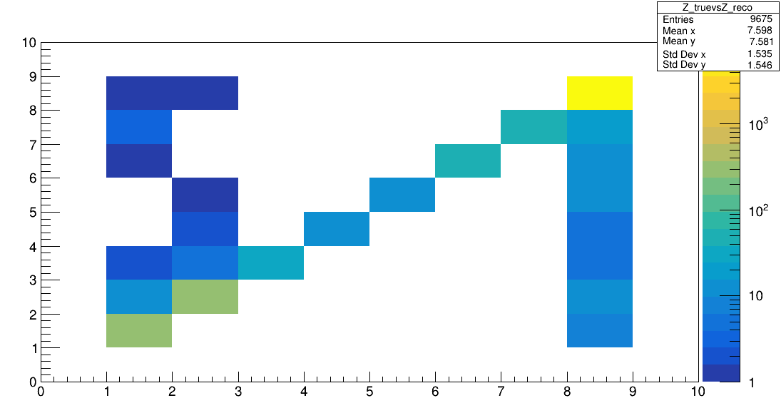
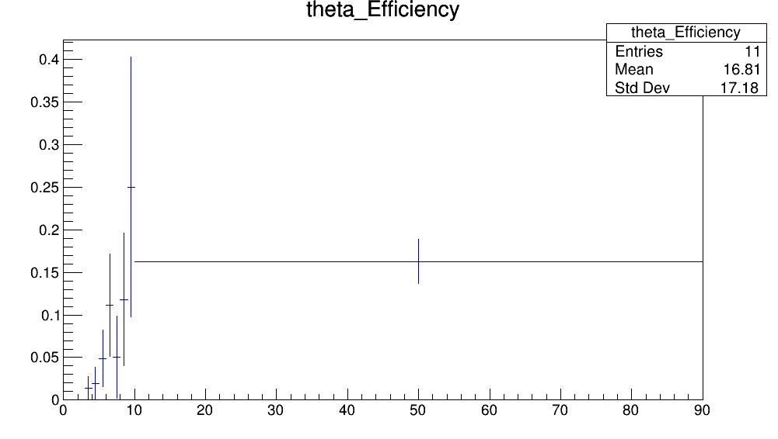
Ingredients GSI2021 setup
Reconstruction efficiency (GSI_2021_MC):
reco tracks / simulated particles
TW Z match
Z_true
eff
~ 10 %
Z_reco
θ (°)
Z=2
Mismatch of Z=1,2,8
→ TW Z reconstruction algo

Slide 4
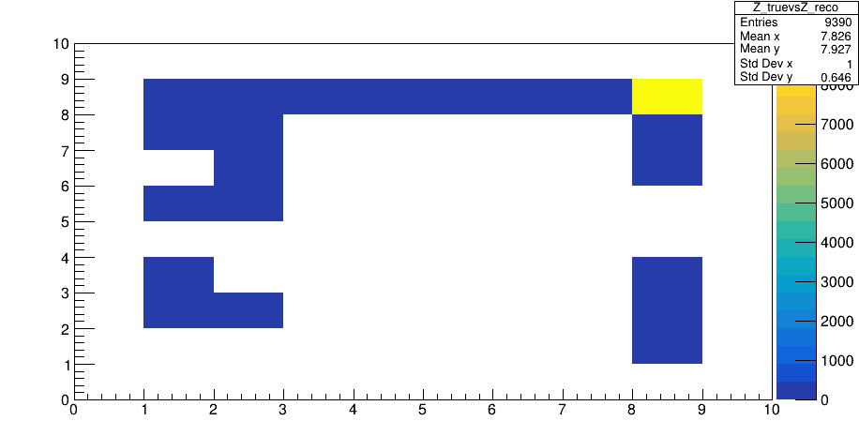
Ingredients full setup 16O_400
Test the full setup for 4-d cross-section
For Reconstruction efficiency:
TW Z match
Z_true
Wrong parametrization of TW
Z reconstruction algo file
(Already in contact with the expert to fix it)
parametrization or on-fly BB measurement?
Z_reco

Slide 5
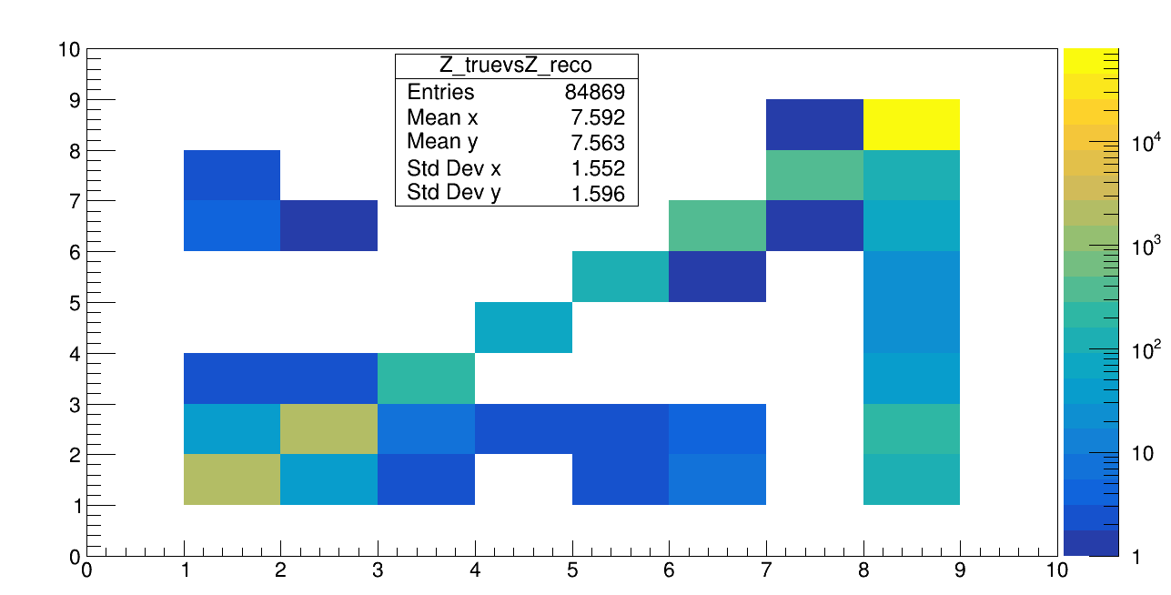
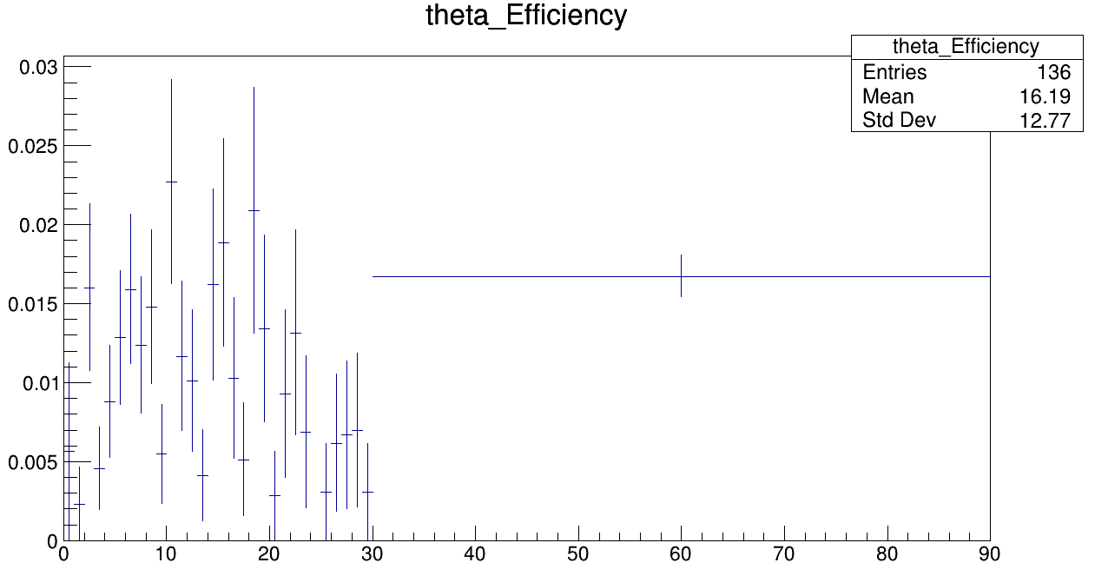
Ingredients full setup
Fixed using True charge in TW point: TWMCMatch
Z_true
TW Z match
eff
~ 10 %
θ (°)
Z_reco
Not so diagonal
→ issue in TW point match with a reco track

Slide 6
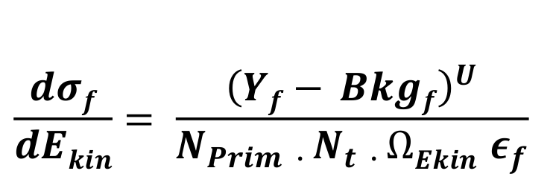
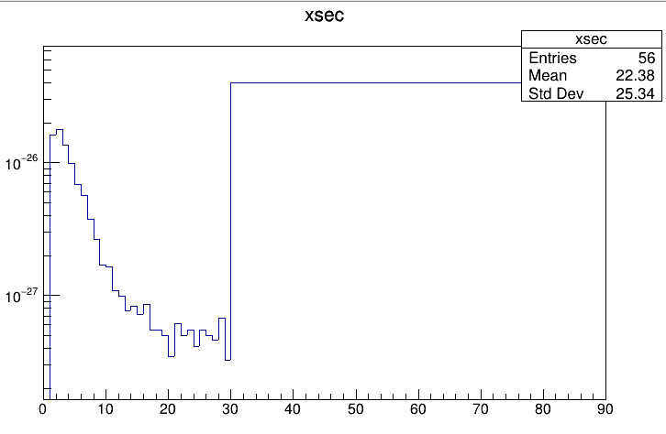
Very very preliminary differential cross section
θ
θ
cm^2
~ 10 mb
θ (°)
Z=2

Slide 7
Conclusions
Work in progress to complete the cross-section analysis in <= 4-dimension
Preliminary estimation of reconstruction efficiencies:
  Issues with TW Z reconstruction algo and
  TW point match with track
  → need dedicated studies
Goal: first cross-section measurement in September for my thesis

Slide 8

GRAZIE E BUONE VACANZE

Slide 9
Global reconstruction
Global reconstruction of an event
Particle ID: Z,A
Kinematics: E,p
Angular distribution: θ
From SHOE branch “glbreco_v1”:
libs/src/TAGfoot/GlobalRecoAna.cxx
.root file with histograms of
variable distribution
Aim of the new software:
Measure differential cross section σ (Z,A,θ,E)
wrt all combination of variables
Written in python
G. Ubaldi

Slide 10
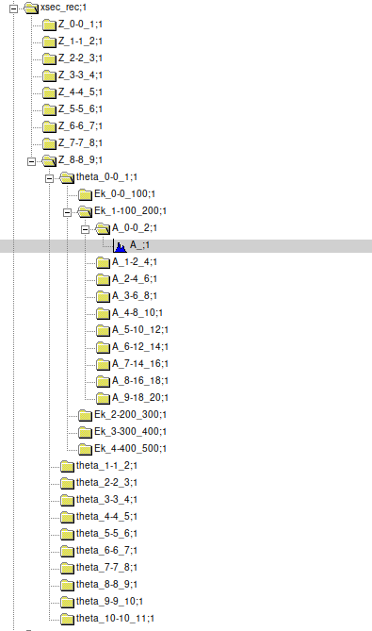
Z
Exampe of
Input file
From SHOE
θ
E
There are only histos of A
Every subdirectory is due to
input binning of the variable
Every histo is univocally discriminated
by its path
A
The software
takes info dinamically about input
variables and binning
Generates differential distribution
wrt all combinations of variables
G. Ubaldi

Slide 11
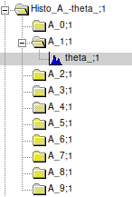
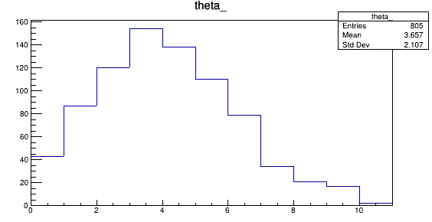
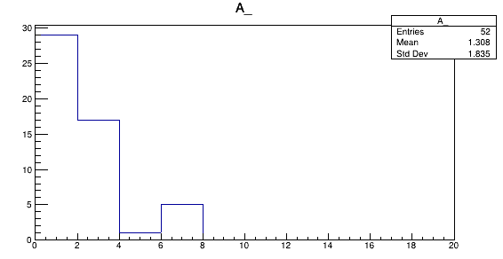
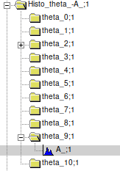
Es. beam of O_16 of 200 Mev/n against a target of C2H4 (MC)
Write_Histo_events ("A_/theta_", eventContainer, outFile,inputPar_dict)
A_1: 2<A<4 amu
    0°<θ<11°
Angle °
Write_Histo_events ("theta_/A_", eventContainer, outFile,inputPar_dict)
θ_9: 9°<θ<10°
    0<A<20 amu
Mass (amu)
G. Ubaldi

Slide 12
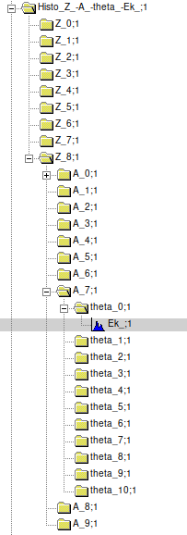
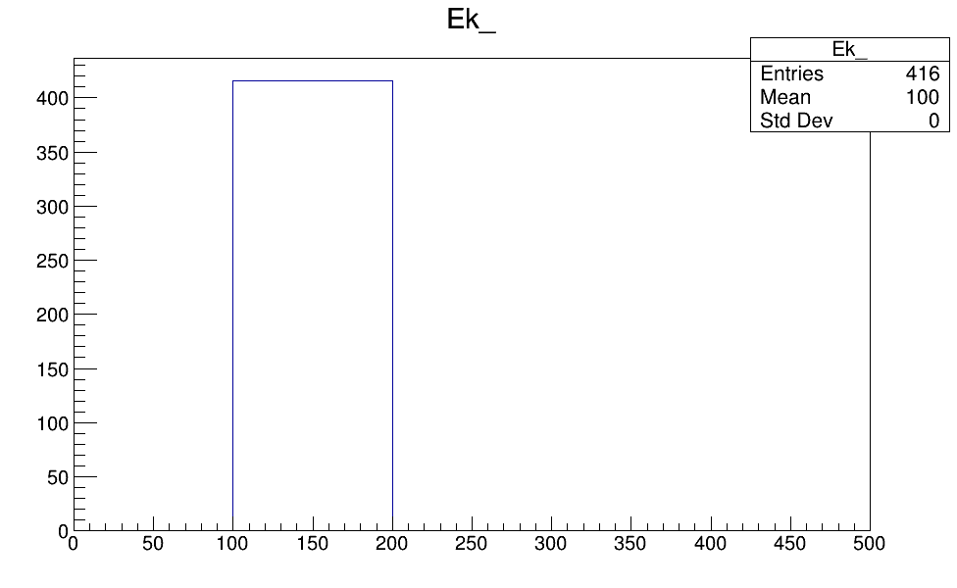
4 – differential distribution
Write_Histo_events ("Z_/A_/theta_/Ek_", eventContainer, outFile,inputPar_dict)
Z = 8
14<A<16
0°<θ<1°
G. Ubaldi

Slide 13
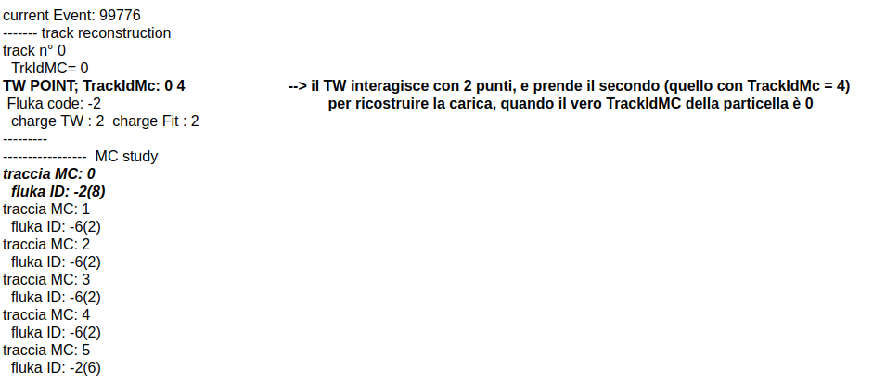
TW point match with the track

Slide 14
TW ALGO wrong Z reconstruction
current Event: 220
------- track reconstruction
track n° 0
TrkIdMC= 0
TW POINT; TrackIdMc: 0
Fluka code: -2
charge TW : 2 charge Fit : 2
---------
----------------- MC study
traccia MC: 0
fluka ID: -2, charge: 8

Slide 15
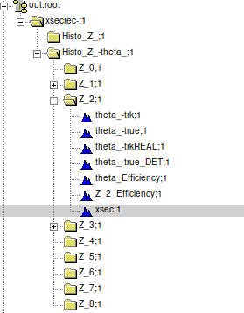
Output directories

Slide 16
https://baltig.infn.it/gubaldi/xshoe
G. Ubaldi

